Slide 1
Splash Screen

Slide 2
Lesson Menu
Five-Minute Check (over Chapter 4)
Then/Now
New Vocabulary
Key Concept: Perimeter
Example 1: Find the Perimeter
Example 2: Find the Length
Key Concept: Area
Example 3: Find the Area
Example 4: Real-World Example: Find the Width

Slide 3
5-Minute Check 1
A. 84
B. 72
C. –72
D. –84

Slide 4
5-Minute Check 2
Solve 3x – 2 = 13. Check your solution.
A. 3
B. 4
C. 5
D. 6

Slide 5
5-Minute Check 3
Translate the sentence into an equation. Then find the number. Eighteen more than four times a number is 54.
A. 4x + 18 = 54; 9
B. 4x + 18 = 54; 8
C. 22x = 54; 2.45
D.

Slide 6
5-Minute Check 4
Translate the sentence into an equation. Then find the number. Six times a number less 4 is –22.
A. 6x = –22; –3.67
B. 6x – 4 = –22; –3.3
C. 6x + 4 = –22; 3
D. 6x – 4 = –22; –3

Slide 7
5-Minute Check 5
Janet’s age is 3 years less than three times her cousin’s age. The sum of their ages is 29. What is Janet’s age?
A. 20 years
B. 21 years
C. 22 years
D. 23 years

Slide 8
5-Minute Check 6
A play is 98 minutes long. The first act of the play is three times as long as the second act. What equation could be used to find the length of the second act of the play?
A. 98 – p = 2p
B. 3p – p = 98
C. 3p + p = 98
D. 3p = 98

Slide 9
Then/Now
You have already found values of algebraic expressions by substituting values for the variables. (Lesson 1–2)
Solve problems involving the perimeters of triangles and rectangles.
Solve problems involving the areas of triangles and rectangles.

Slide 10
Vocabulary
formula
literal equation
perimeter
area

Slide 11
Concept A

Slide 12
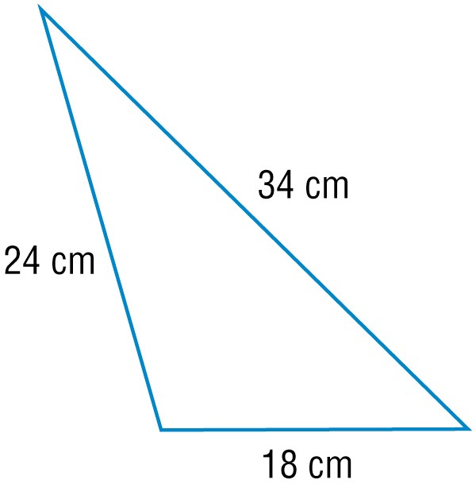
Example 1
Find the Perimeter
Find the perimeter of the triangle.
P = a + b + c Write the formula for perimeter.
P = 24 + 34 + 18 Replace a with 24, b with 34, and c with 18.
P = 76 cm Simplify.
Answer: 76 cm

Slide 13
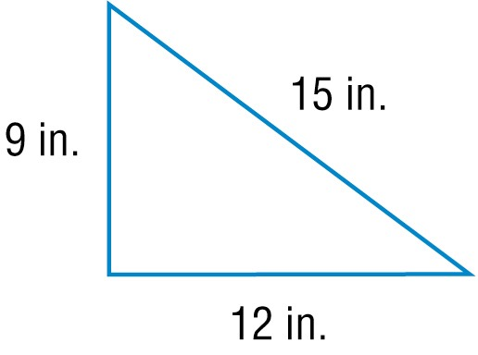
Example 1
What is the perimeter of the triangle?
A. 27 in.
B. 36 in.
C. 45 in.
D. 48 in.

Slide 14
Example 2
Find the Length
The perimeter of a rectangle is 60 feet. Its width is 9 feet. Find its length.
Write the formula.
Replace P with 60 and w with 9.
Simplify.
Subtract 18 from each side.
Simplify.
Mentally divide each side by 2.
Answer: The length is 21 feet.

Slide 15
Example 2
The perimeter of a rectangle is 36 meters. Its width is 6 meters. Find its length.
216 meters
24 meters
12 meters
6 meters

Slide 16
Concept B

Slide 17
Example 3
Find the Area
The base of a triangle is 10 inches and the height is 7 inches. Find the area.
Write the formula for area.
Replace b with 10 and h with 7.
Simplify.
Answer: 35 in²

Slide 18
Example 3
The base of a triangle is 14 centimeters and the height is 8 centimeters. What is the area of the triangle?
A. 48 cm²
B. 56 cm²
C. 80 cm²
D. 92 cm²

Slide 19
Example 4
Find the Width
SEEDING Mrs. Winston has a small bag of grass seed that will seed 750 square feet. If the area she wants to reseed is 30 feet long, how wide can the area be?
Understand You know Mrs. Winston needs to seed a rectangle that is 30 feet long and has enough seed to cover an area of 750 square feet. You need to find the width of the rectangle.
Plan Use the formula to find the width.

Slide 20
Example 4
Find the Width
Solve Solve for w. Then substitute.
Write the formula for area.
Divide each side by .
Simplify.
Replace A with 750 and with 30.
Simplify.

Slide 21
Example 4
Find the Width
Answer: The area can be 25 feet wide.
Check Check by multiplying. 30 × 25 = 750. ✓

Slide 22
Example 4
PAINT Amy has enough paint to cover 630 square feet. She wants to paint a rectangular stripe along a wall that is 45 feet long. How wide can the stripe be?
A. 14 ft
B. 15 ft
C. 16 ft
D. 20 ft

Slide 23
End of the Lesson

